Slide 1

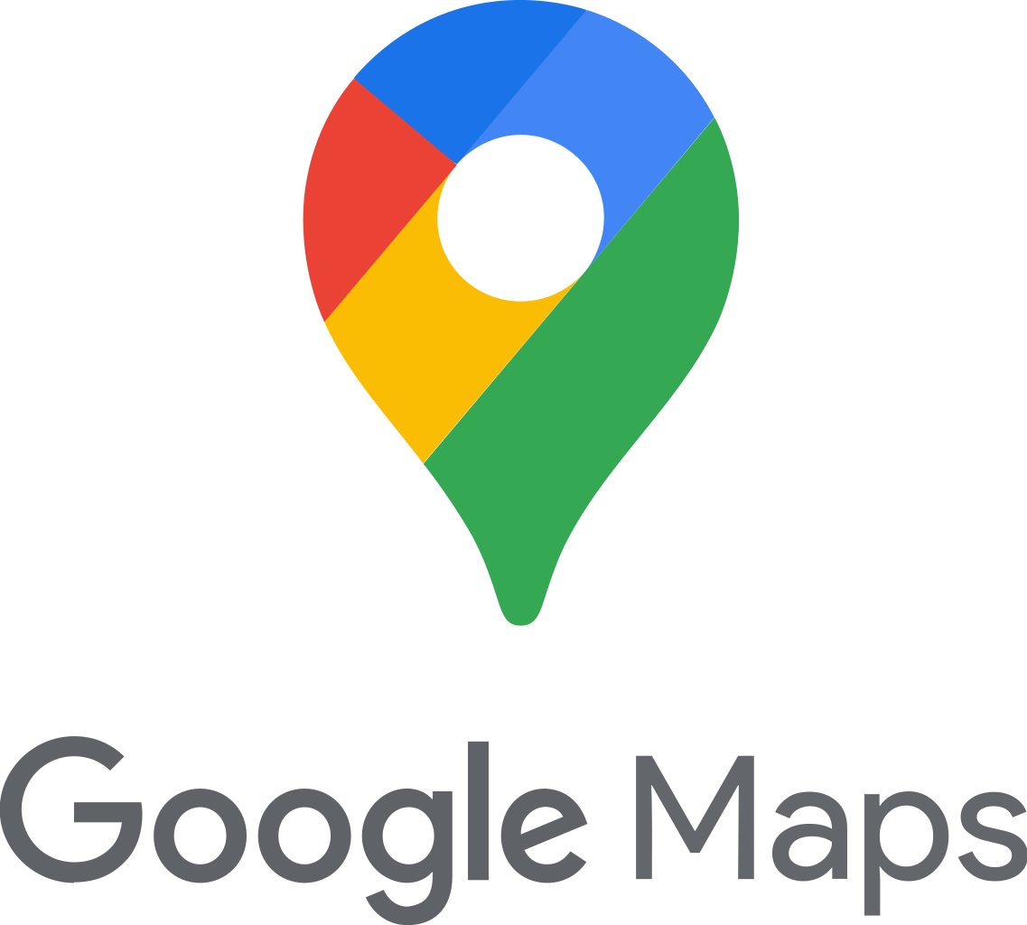
DATA STUCTURE
DATA STRUCTURES USED IN GOOGLE MAPS

Slide 2
PRESENTED BY: -
NAME | REG NO. | GROUP
SUBHASHREE PATRA | 2201020794 | COMPUTER SCIENCE AND IT “8A”
JYOTI PATRA | 2201020813
INDRANEEL MOHAPATRA | 2201020822
KADAMBINI BEHERA | 2201020835
SAI SRUJANI MISHRA | 2201020879
RAKESH KUMAR | 2201020880

Slide 3
CONTENTS
Introduction
DS used in Google Maps
Output
Algorithm
Experimental Analysis
Advantages
Disadvantages
Conclusion

Slide 4

INTRODUCTION
Google Maps has become an integral part of our daily lives, revolutionizing the way we navigate and explore the world around us. With its user-friendly interface and extensive features, Google Maps has proven to be an indispensable tool for both individuals and businesses.

Slide 5
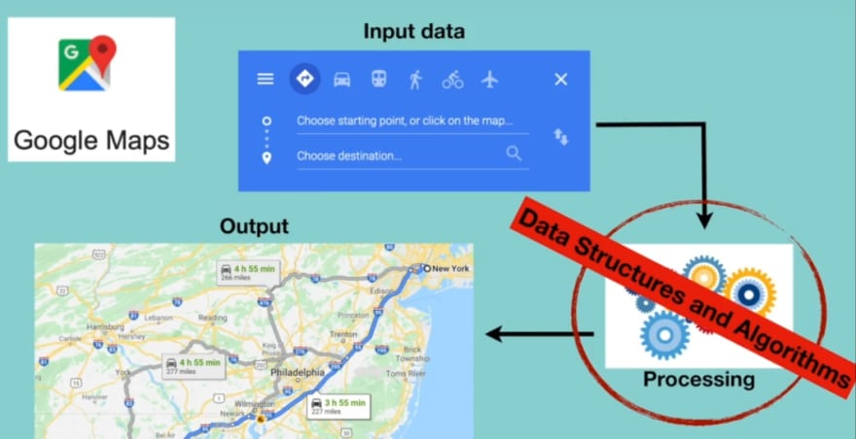

Slide 6
DATA STRUCTURES USED IN GOOGLE MAPS
Google Maps relies on a variety of data structures to efficiently store, manage, and process geographic and location-based data.
Some of the key data structures used in Google Maps include:
Graphs
Spartial Data Structures
Hash Tables
Quad-Trees
Geohashes
Priority Queues

Slide 7
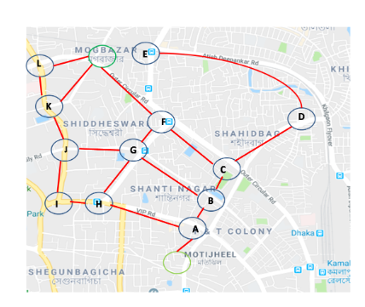
GRAPH
Graphs are used to represent road networks in Google Maps.
Nodes in the graph represent intersections or locations, while edges represent the roads connecting them.
This representation allows for efficient traversal and pathfinding algorithms to calculate routes between locations.

Slide 8
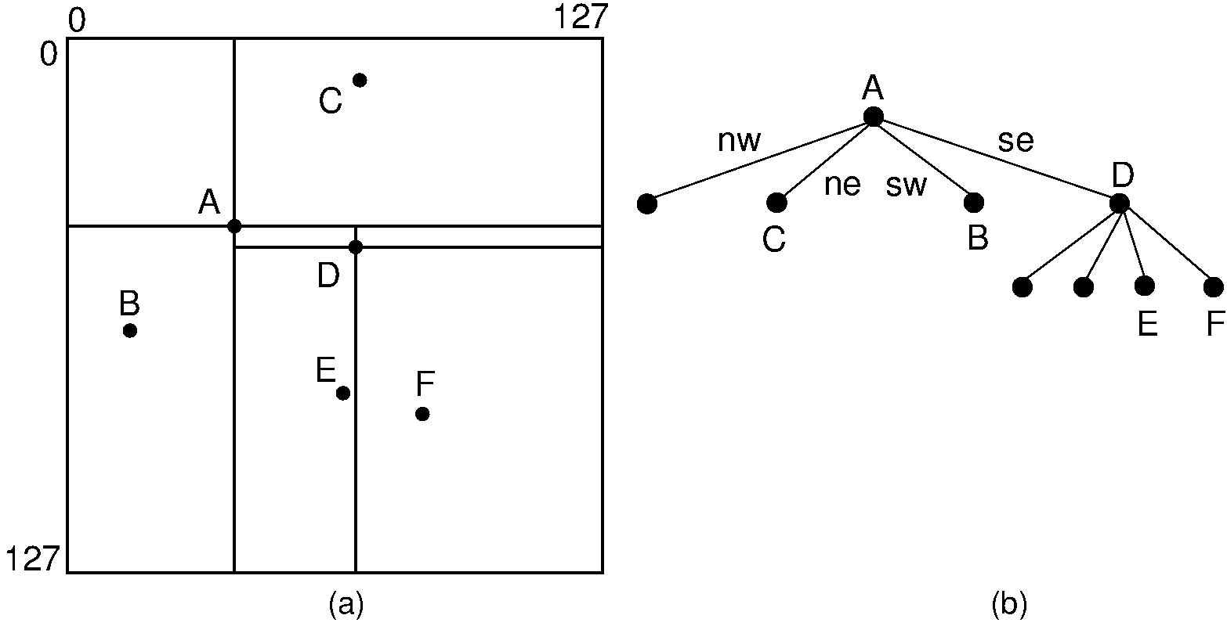
SPATIAL DATA STRUCTURES
Spatial data structures are employed to manage geographical data in Google Maps.
These structures, such as quad trees or R-trees, organize spatial data based on their location coordinates.
They enable efficient spatial indexing and querying, allowing for fast retrieval of nearby points of interest or road segments during route planning and navigation.

Slide 9
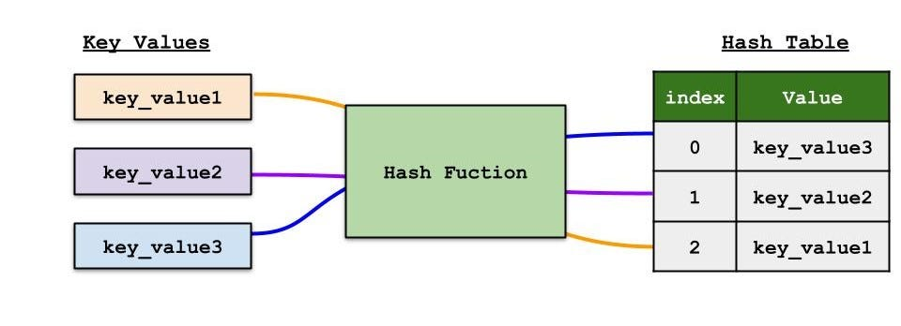
HASH TABLES
Hash tables are employed in Google Maps for efficient data storage and retrieval.
They are used to store information about points of interest, addresses, and other relevant data.
Hash tables provide fast access to data based on a unique key, enabling quick retrieval of information during route planning and navigation.

Slide 10
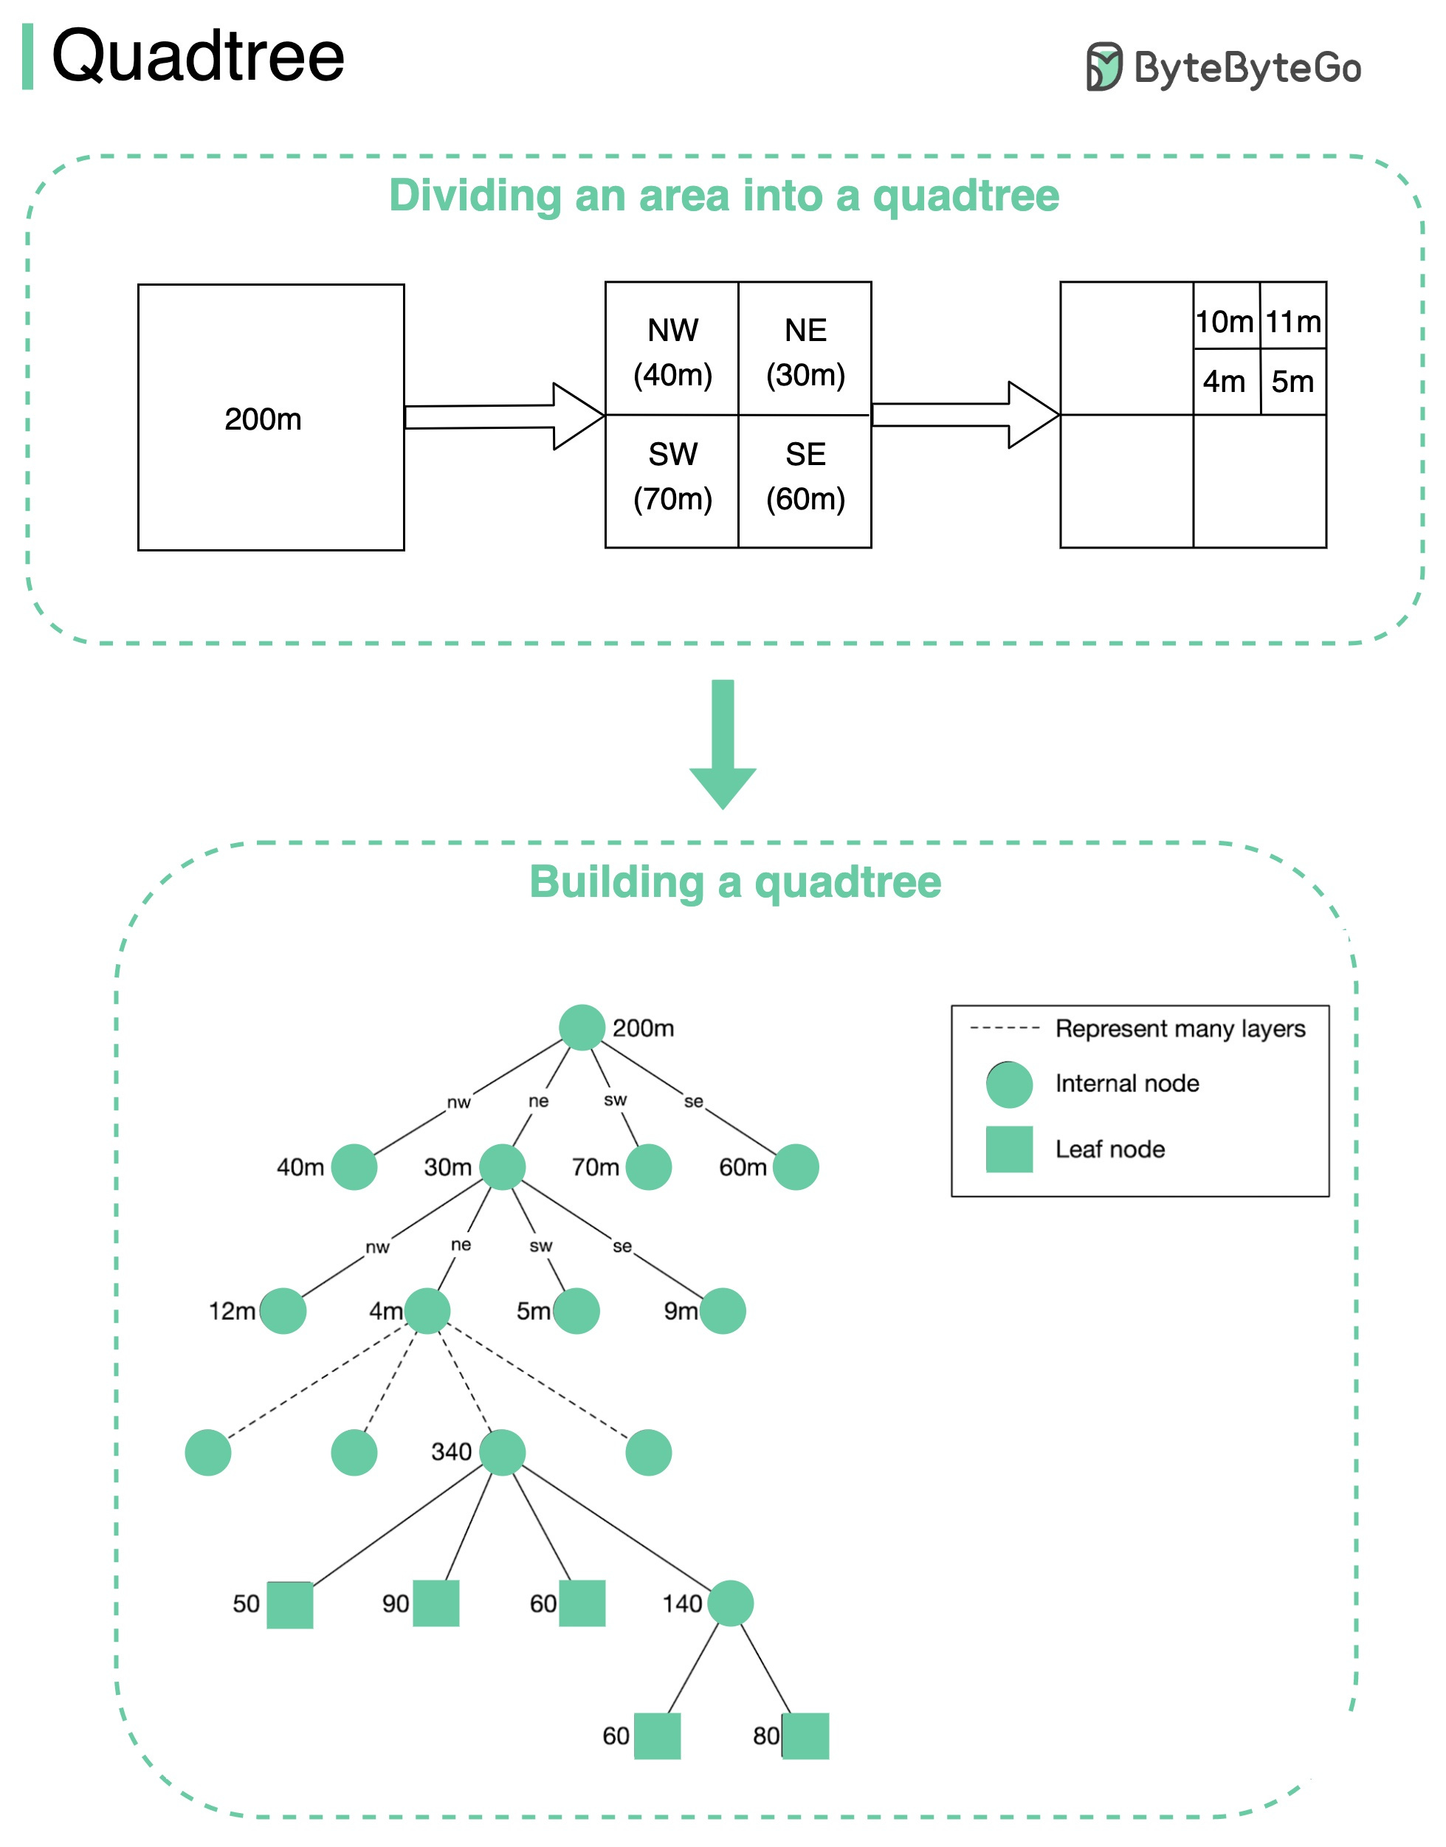
QUAD-TREES
Quad-trees are hierarchical spatial data structures that help divide geographic regions into smaller cells for efficient indexing and searching.
Google Maps uses quad-trees for tasks like location-based search and map display.
They enable efficient storage, indexing, and retrieval of map tiles and other geographic data, ensuring that users can explore maps at different zoom levels while minimizing data loading times and computational overhead

Slide 11
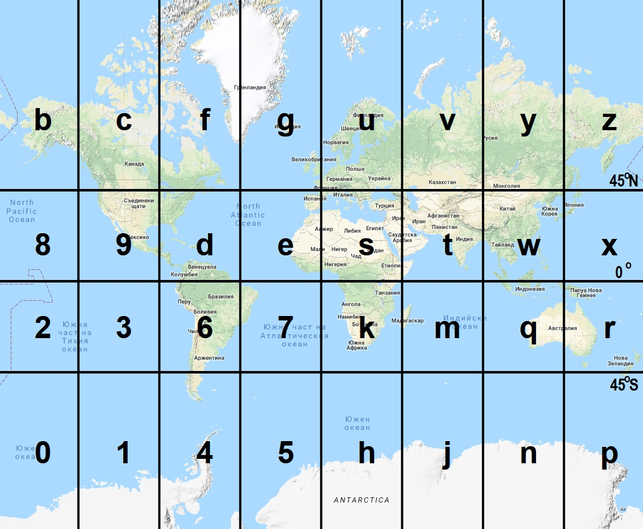
GEOHASHES
Geohash is a geocoding system that encodes geographic coordinates into a short string of letters and digits. It's used for indexing and efficient retrieval of location-based data.
Google Maps, along with many other location-based services, relies on geohashes as a fundamental tool for organizing and processing geographic data efficiently and accurately.
Geohashes offer a versatile and practical solution for location-based applications.

Slide 12
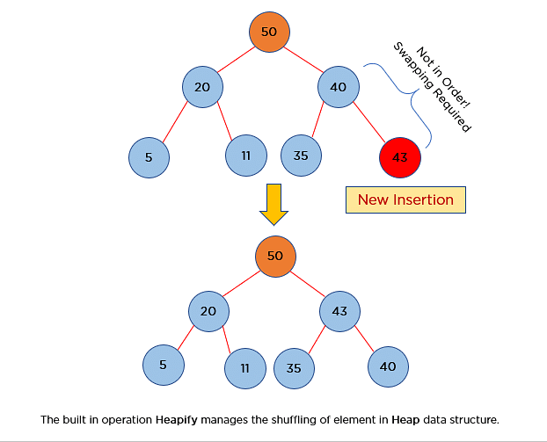
PRIORITY QUEUES
Priority queues or heaps play a crucial role in optimal route calculation in Google Maps.
These data structures prioritize the order in which nodes are visited during route planning based on factors such as distance, travel time, or traffic conditions.
By using priority queues or heaps, Google Maps can determine the most optimal route efficiently.

Slide 13
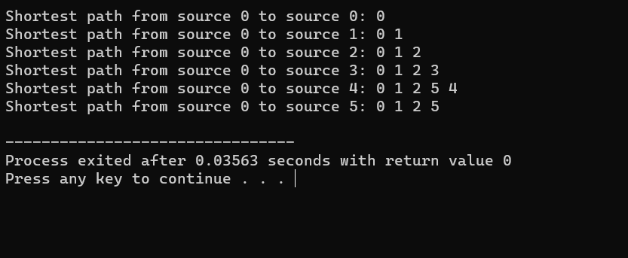
OUTPUT

Slide 14
DIJKSTRA'S ALGORITHM

Slide 15
DIJKSTRA'S ALGORITHM
Dijkstra's algorithm is a fundamental graph search algorithm used in Google Maps for finding the shortest and fastest routes between locations.
Graph Representation: Represents road networks as a weighted, directed graph.
Initial Setup: Initializes with start and end points and assigns tentative distances.
Main Loop: Repeatedly selects unvisited node with the smallest tentative distance.

Slide 16
DIJKSTRA'S ALGORITHM
Exploration of Neighbors: Explores neighbors, calculates tentative distances, and updates values.
Marking as Visited: Marks nodes as visited once explored.
Shortest Path Reconstruction: Traces back from destination to source for the optimal route.
Real-Time Traffic: Integrates real-time traffic data for fastest routes.
Alternate Routes: Computes alternate routes for user choice.
Intermodal Routing: Supports multiple modes of transportation.
Multi-Stop Directions: Optimizes routes for multiple stops.

Slide 17
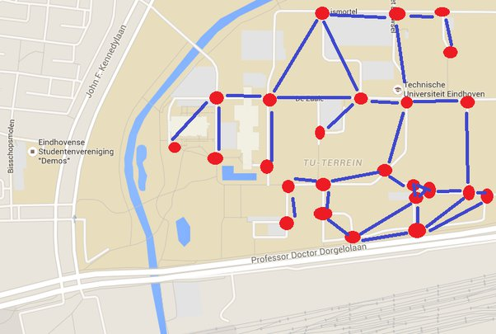
DIJKSTRA'S ALGORITHM

Slide 18
EXPERIMENTAL ANALYSIS
The performance and efficiency of the data structures and algorithms used in Google Maps have been extensively evaluated and optimized to provide fast and accurate route calculations. Here is an analysis of their performance:
Speed and Efficiency
Route Calculation Accuracy
Handling Large Scale Mapping Data

Slide 19
ADVANTAGES
The proposed approach of using data structures and algorithms in Google Maps offers several advantages, including:
Faster Route Planning
Real Time Update
Scalability For Global Usage

Slide 20
DISADVANTAGES
However, there are also potential disadvantages or limitations to this approach, such as
High Data Storage Requirements
Occasional Inaccuracies in Traffic Prediction

Slide 21
CONCLUSION
In conclusion, the significance of data structures in enhancing Google Maps cannot be overstated. By leveraging efficient data structures and algorithms, Google Maps has transformed the way people navigate and plan their routes. With continuous research and improvements, Google Maps will continue to provide users with faster, more accurate, and personalized navigation experiences.

Slide 22
Thank you

